Slide 1

Categorical perception
Categories in sensation/perception (non-semantic)

Slide 2
Logic of categorical perception
Categorical perception: the phenomenon in which people perceive stimuli from different categories as more different from each other than stimuli from within the same category.
Why useful? Introduces invariance in response with respect to a functionally defined category.
In speech: adjusts for different ways in which a speaker utters sounds.
Rapid prediction; efficient memory; compression

Slide 3
Logic of categorical perception
Demonstrating:
Select a set of stimuli that uniformly covers a certain physical domain (e.g., sound freq 100Hz – 8000Hz)
Select an objective distance measure; e.g., distance in frequency space (applicable to both sounds and colors)
Select a method for operationalizing human similarity (e.g., similarity judgments, generalization, confusion [same/different])
In one procedure: assign all stimuli to categories;
In a second, obtain similarity judgments for within-category vs. between-category pairs, or ask for categorization, and evaluate if the boundary is fuzzy or not.

Slide 4
In audition
In auditory stimuli, discrimination between speech sounds: People have a sharper discrimination boundary between sounds that are perceived as belonging to different phonetic categories than between sounds that are perceived as belonging to the same category.
The objective dimension: Voice Onset Time of consonants
Present consonants such as /b/ and /p/. A fixed-size physical difference in VOT that was easily discriminated when it straddled the boundary between two categories (labeled as /b/ or /p/), produced chance discrimination performance when both tokens came from the same category (either both /b/ or both /p/).
labeling of these consonants was perfectly predicted by the ability to discriminate small differences in an acoustic parameter called voice onset time (VOT).

Slide 5
If a phonetic category boundary does not exist, the two stimuli will continue sounding the same
When a functional contrast does exist, the phonetic categories are learned VERY quickly.
Eimas et al. 1971: 4-month old sucking rate (more == surprise) as function relation between current and previously heard stimuli
They presented two stimuli with VOT differing by 20ms.
In one condition ‘D’ the difference straddled the border of a phonetic boundary (stimuli perceived as ‘b’ and ‘p’ by adults
In another condition ‘S’ the belonged to the same phonetic category.

Slide 6
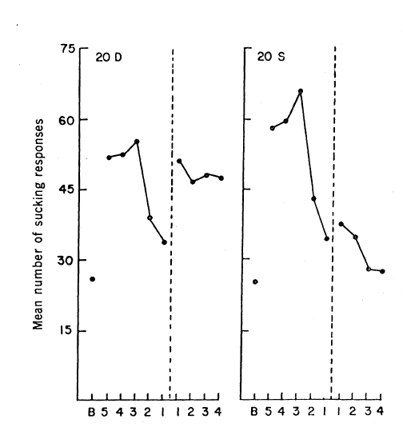
If a phonetic category boundary does not exist, the two stimuli will continue sounding the same
‘Different’: 5 min habituation but then surprise
‘Same’: Continuous habituation
5 minute of habituation precede a 20ms vot change, either within the same or across phonetic category (20S vs 20D)

Slide 7
Related phenomenon
Categorical perception is one way in which prior categories aid online processing, and demonstrates a basic sort of experience-dependent learning. Related phenomenon
Change Deafness. Vitevitch 2003: had participants repeat words presented in a stream. Halfway through study, the voice changed. Only 40% of participants noticed the change in speaker
Sine-wave speech: phonetic categories can be considered a priors on sounds that may be heard as speech. A very simple demonstration that expectations (via learning/fine-tuning) can impact whether a stimulus is perceived as speech
http://www.lifesci.sussex.ac.uk/home/Chris_Darwin/SWS/

Slide 8
Categorical perception in color
CP for color: discrimination of items that cross category boundaries is better (faster, more accurate) than when the items are within the same color category. NOTE: color category is LINGUISTIC
For example: easier to distinguish between a green stimulus and a blue stimulus than between two stimuli within the same category (two shades of green), who are spaced at the same distance.
In other words: better cross-category (vs. within-category) discrimination is only found when the physical distance between within-category items are equivalent.
(Practical) Note: Color differences in terms of discriminability can be equated across between-category and within-category comparisons by using the Commision Internationale de L’Eclairage (CIE) values.

Slide 9
Visual Categorical perception in different language
Roberson, D., Davies, I., Davidoff, J.: Color categories are not universal: replications and new evidence from a stone-age culture. J. Exp. Psychol. Gen. 129, 369–398 (2000)
A stone-age tribe Berinmo uses gives the same name that in English fall under both green and blue. They also have category boundary between ‘nol’ and ‘wor’ that doesn’t exist in English
Berinmo: better discrimination of 32 cross-category items than 32 within-category items at the boundary between nol and wor. English speakers did not show CP at this boundary.
Berinmo: No CP at the boundary between green and blue (no boundary in their language)

Slide 10
